Slide 1


<Name>
<Date>

Slide 2

Outline
Executive Summary
Introduction
Methodology
Results
Conclusion
Appendix

Slide 3
Executive Summary
Summary of methodologies
Summary of all results

Slide 4
Introduction
Project background and context
Problems you want to find answers

Slide 5

Section 1

Slide 6
Methodology
Executive Summary
Data collection methodology:
The data was collected through web scrapping methodology and i used the GET request to the SpaceX API which was received in a json format. Then the json file was normalized to store in a dataframe format in pandas for further analysis.
Since the data identified from the API was more filled with identification numbers , I used the API again to get the required information about the launches using the IDs given for each launch to get more info on Booster name,Payloads,launch pads,flight numbers,Successful launches and launch sites for falcon 9.
Perform data wrangling
Calculated the number of launches on each SpaceX launch facilities and tried to find out how many launches are done. Also, the number of occurrences of each orbit taken in to account.
Categorized the outcomes for each orbit based on Outcome columns then categorized the outcome CLASS 0 or 1 based on the success and failed outcomes.
Perform exploratory data analysis (EDA) using visualization and SQL
Found interesting insights on data like unique launch sites,last successful launch date, what are the total payload-mass carried by falcon 9 and analysed the booster versions used,
Perform interactive visual analytics using Folium and Plotly Dash
Plotted the sites using folium maps by clustering the outcomes and launch sites and identified if a particular site is nearest to roads, railways and coast line.
Plotted the findings in an interactive dashboard and presented the findings.
Perform predictive analysis using classification models
Used multiple methodologies like GridSearch with Decision Tree classifier, KNN,SVM and found the best score by fitting the splitted training and test data .

Slide 7
Data Collection
The data to analyze was available in the SpaceX website from Url spacex_url="https://api.spacexdata.com/v4/launches/past"
Using REST API , using web scraping, data is downloaded in JSON format. To check the response using the below code
response = requests.get(spacex_url)
Since the data had lots of Identification numbers, I used the API again to information on columns like rocket, payloads, launchpad, and cores.

Slide 8
Data Collection – SpaceX API
Present your data collection with SpaceX REST calls using key phrases and flowcharts
CapstoneSpacex_Flacon9Prediction/jupyter-labs-spacex-data-collection-api.ipynb at main · vathson20/CapstoneSpacex_Flacon9Prediction (github.com)
Python API request URL
REST Call – Get request
SPCEX URL
Processing
JSON output
JSON
Response code : 200
Response,,content

Slide 9

Data Collection - Scraping
Present your web scraping process using key phrases and flowcharts
CapstoneSpacex_Flacon9Prediction/jupyter-labs-webscraping .ipynb at main · vathson20/CapstoneSpacex_Flacon9Prediction (github.com)
GET Request to wiki URL
Static Wiki URL
Get request
Response Object
HTML Parser using Beautiful Soup object
Extract the details in a Dataframe using HTML tables
Extract Tables using HTML headers using soup object

Slide 10


Data Wrangling
After the data is collected using web scraping, I did some EDA to get more insights on the falcon9 data and determining the training labels for predictions.
Read the dataset using pandas into a dataframe.
Calculate the number of launches on each site and calculate the number and occurrences of each orbit.
Further, I calculated the number and occurrence of mission outcomes of the orbits.
Based on the outcomes, (TRUE ASDS, FALSE ASDS,NONE NONE), I categorized the data into 0 and 1 for ood and bad outcomes.
Then I created the label ‘Class’ to convert all good outcomes to 1 and bad outcomes to 0 so that we have a category which explains the successful and failure launches.
EDA
CSV File Generated from Web scrapping – Data collection
Pandas Data frame
Occurrences on each orbit
No of launch sites
Outcomes of each orbit
Categorize the outcomes in Class
1- Successful Launch
0- UnSuccessful Launch

Slide 11




EDA with Data Visualization
Using the EDA technique, the below plots are plotted to get more insights for feature engineering:
Catplot between Flight Number and Payload mass.
Plotted the relationship between Flight number and Launch site using scatter plot point chart
Plotted the relationship between launch sites and their payload mass.
Plotted the bar chart to understand the success rate of each orbit type.
Plotted the scatter plot to understand the relation between flight number and orbit type.
Visualized relation between payload and orbit type using a scatter plot
Visualized the trends yearly between years using lineplot.
CapstoneSpacex_Flacon9Prediction/jupyter-labs-eda-dataviz.ipynb at main · vathson20/CapstoneSpacex_Flacon9Prediction (github.com)
EDA using Plotly and SNS
Pandas Data frame

Slide 12
EDA with SQL
Created a sqllite database and connect to the table.
Found the various launch sites and found the sample records for a particular launch site.
Found the total payload mass carried by NASA (CRS).
Found the average total mass carried by booster version F9 v1.1.
Further, I found out the date when was the last successful launch happened.
Learnt the names of the boosters which have success in drone ship and have payload mass greater than 4000 but less than 6000
Found out total number of successful and failure outcomes.
Found which booster versions which have carried the maximum payload.
Found the data which had failure landingoutcomes in drone ship ,booster versions, launch_site for the months in year 2015.
Further, I ranked the count of landing outcomes (such as Failure (drone ship) or Success (ground pad)) between the date 2010-06-04 and 2017-03-20, in descending order.
Please refer to code below:
CapstoneSpacex_Flacon9Prediction/jupyter-labs-eda-sql-coursera_sqllite.ipynb at main · vathson20/CapstoneSpacex_Flacon9Prediction (github.com)

Slide 13
Build an Interactive Map with Folium
Created a initial Map object for Nasa coordinates and mapped all the launch sites on the map using the coordinates given in the file using the circle marker and marker to know the launch sites.
Then Using a marker cluster, I mapped all the successful and failed launches on each site to know the where exactly the launches happened and near to any important location on earth.
Then To find the nearest distance to proximity city, using lines, I calculated the distance and plotte the same in map.
Interestingly, it is found that all launch sites are away from cities and proximity to coastal area.
Explain why you added those objects
CapstoneSpacex_Flacon9Prediction/lab_jupyter_launch_site_location.ipynb at main · vathson20/CapstoneSpacex_Flacon9Prediction (github.com)

Slide 14
Build a Dashboard with Plotly Dash
The Lab portal was not working so could not do the dashboards.

Slide 15
Predictive Analysis (Classification)
Summarize how you built, evaluated, improved, and found the best performing classification model
I chose Grid search method to find out which method is suited best to predict the successful launch.
Loaded the dataframe and created an array to store the Y values.
Then I standardized the values of df using standard scaler and fit transform the values.
Split the data into training and test data.
Create a linear regression object and assign the GRIDSEARCHCV object parameters.
Fit the training data and find the appropriate hyper parameters and score value .
Fit the test data and find the score using score() method.
Create a confusion matrix to understand the test data and predictions.
Repeat the steps above 3 steps for SVM,Decision Tree, KNN algorithms.
Find the best model using the score obtained.
CapstoneSpacex_Flacon9Prediction/SpaceX_Machine_Learning_Prediction_Part_5.jupyterlite.ipynb at main · vathson20/CapstoneSpacex_Flacon9Prediction (github.com)
Identify the features
Split the data in to training and Test
Fit the training data
Find the best hyper parameters and score
Fit the test data and find the accuracy score
Create the GRID Search CV object for the identified algorithm.
Repeat the process for another algorithm models

Slide 16
Results
Different launch sites have different success rates. CCAFS LC-40, has a success rate of 60 %, while KSC LC-39A and VAFB SLC 4E has a success rate of 77%.
We can observe that the success rate since 2013 kept increasing till 2017 (stable in 2014) and after 2015 it started increasing.
With heavy payloads the successful landing or positive landing rate are more for Polar,LEO and ISS.
However for GTO we cannot distinguish this well as both positive landing rate and negative landing(unsuccessful mission) are both there here.
We can see that in the LEO orbit the Success appears related to the number of flights; on the other hand, there seems to be no relationship between flight number when in GTO orbit.
Orbits like ES L1,GEO ,SSO and HEO has high success rate.
From Payload Vs. Launch Site scatter point chart we find for the VAFB-SLC launchsite there are no rockets launched for heavypayload mass(greater than 10000).
We see that the models KNN and logreg performed well and we can consider that for prediction.

Slide 17

Section 2

Slide 18
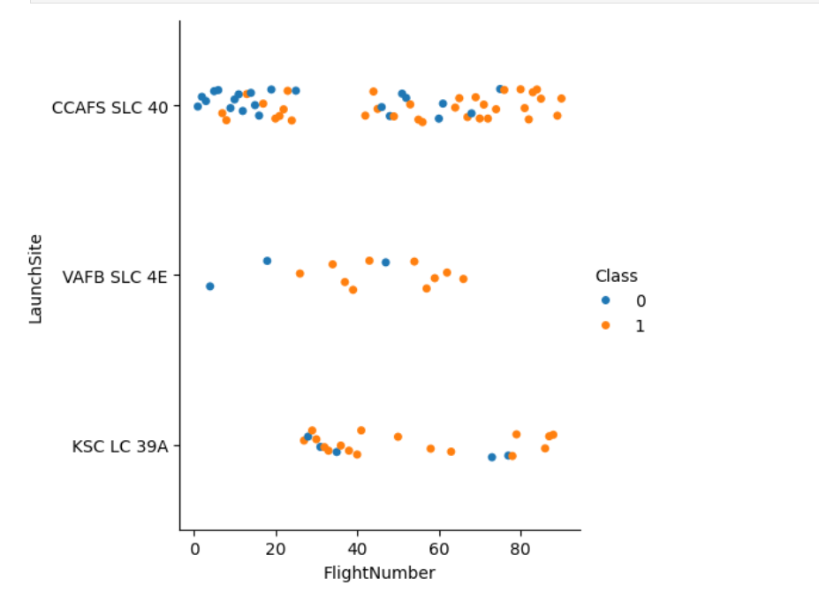
Flight Number vs. Launch Site
Show a scatter plot of Flight Number vs. Launch Site

Slide 19
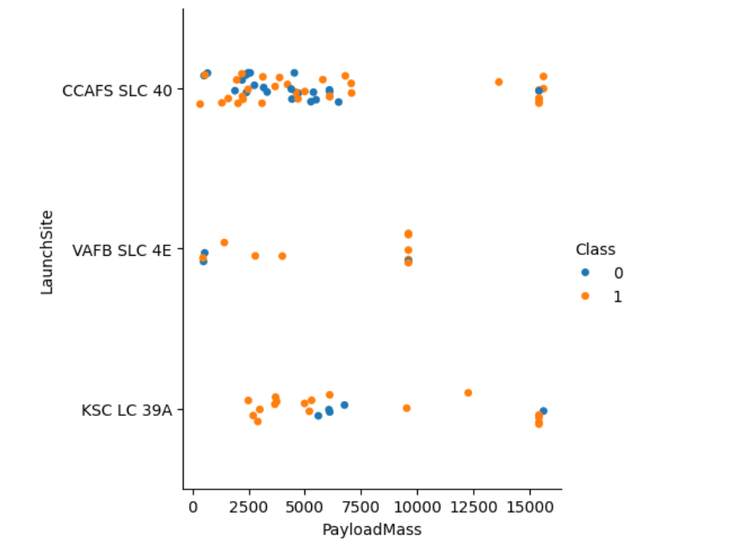
Payload vs. Launch Site
Observation: Payload Vs. Launch Site scatter point chart you will find for the VAFB-SLC launchsite there are no rockets launched for heavy payload mass(greater than 10000).

Slide 20
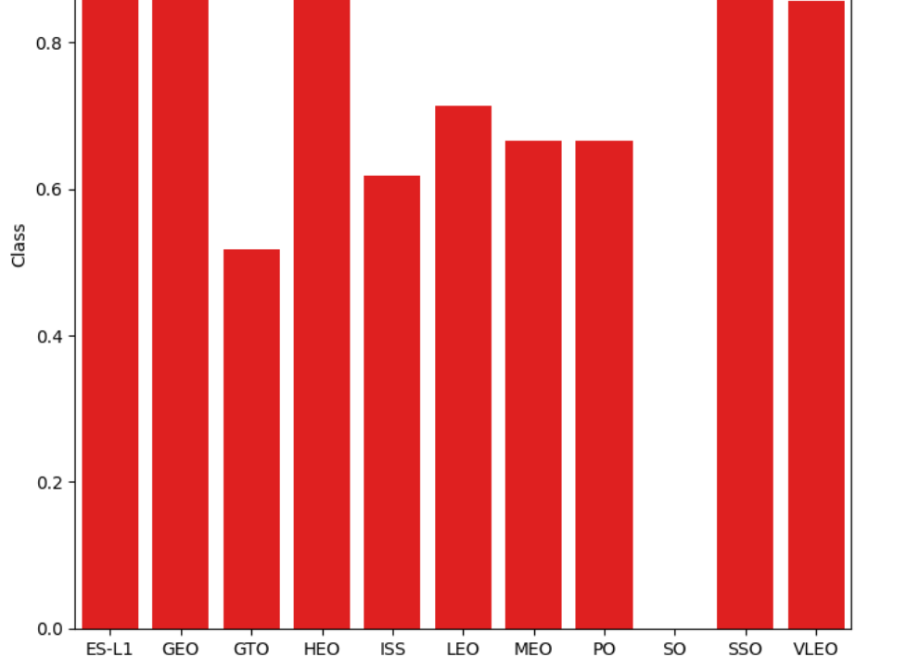
Success Rate vs. Orbit Type
We find that the orbits ES l1, GEO,HEO and SSO and very high success rate(Around 1)

Slide 21
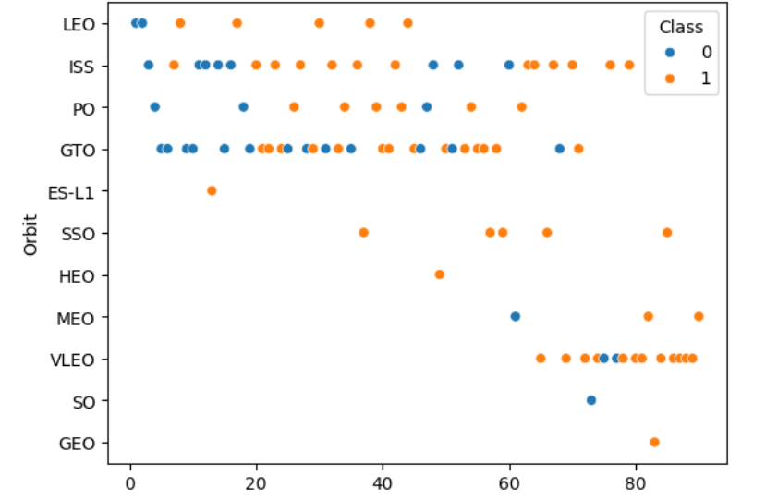
Flight Number vs. Orbit Type
In the LEO orbit the Success appears related to the number of flights; on the other hand, there seems to be no relationship between flight number when in GTO orbit.

Slide 22
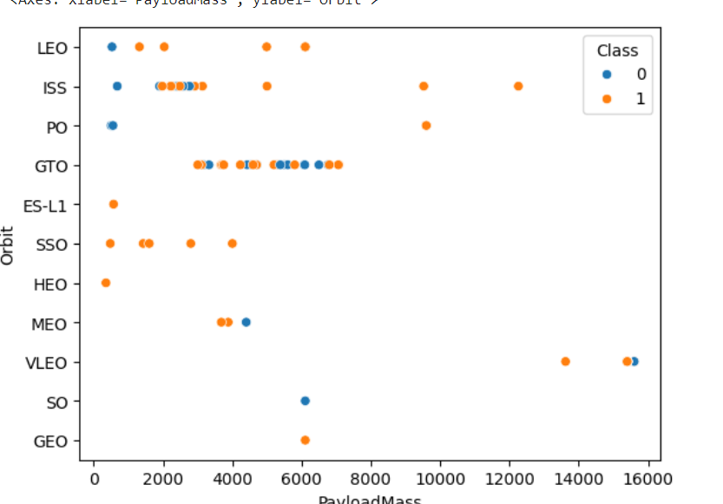
Payload vs. Orbit Type
With heavy payloads the successful landing or positive landing rate are more for Polar,LEO and ISS. However for GTO we cannot distinguish this well as both positive landing rate and negative landing(unsuccessful mission) are both there here.

Slide 23
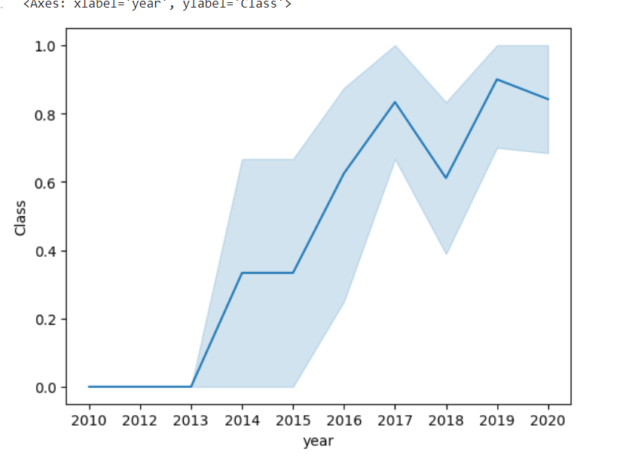
Launch Success Yearly Trend
The success rate since 2013 kept increasing till 2017 (stable in 2014) and after 2015 it started increasing.

Slide 24
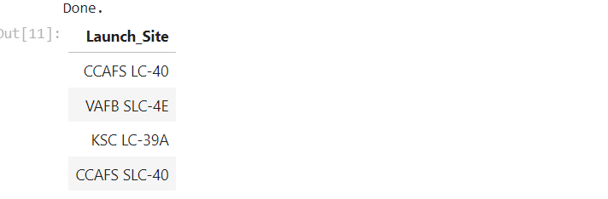
All Launch Site Names
Find the names of the unique launch sites
CCAFS-40
VAFB SLC- 4E
KSC LC- 39A
CCAFS SLC -40

Slide 25
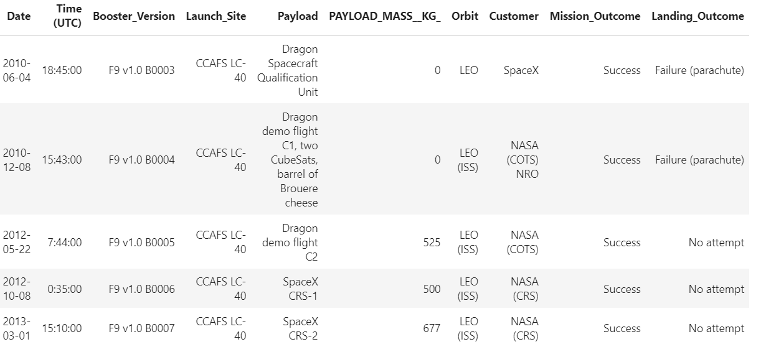
Launch Site Names Begin with 'CCA'
Two failures with parachute but landing is success.

Slide 26
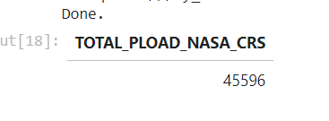
Total Payload Mass
Calculate the total payload carried by boosters from NASA
Total mass is 45596 Kgs

Slide 27
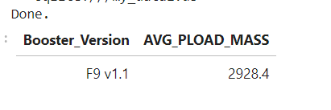
Average Payload Mass by F9 v1.1
Calculate the average payload mass carried by booster version F9 v1.1

Slide 28
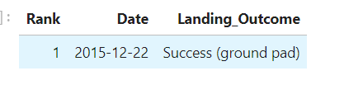
First Successful Ground Landing Date
Find the dates of the first successful landing outcome on ground pad

Slide 29
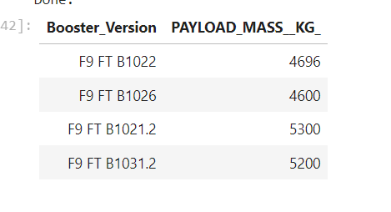
Successful Drone Ship Landing with Payload between 4000 and 6000
List the names of boosters which have successfully landed on drone ship and had payload mass greater than 4000 but less than 6000

Slide 30
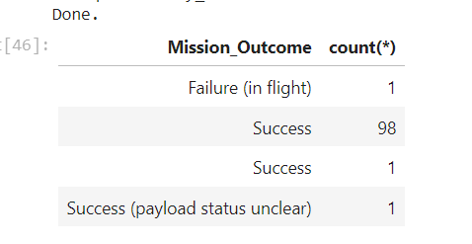
Total Number of Successful and Failure Mission Outcomes
Calculate the total number of successful and failure mission outcomes.

Slide 31
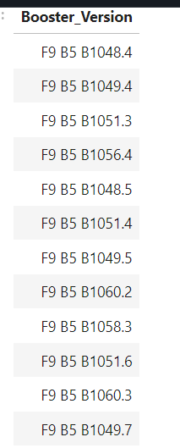
Boosters Carried Maximum Payload
List the names of the booster which have carried the maximum payload mass

Slide 32
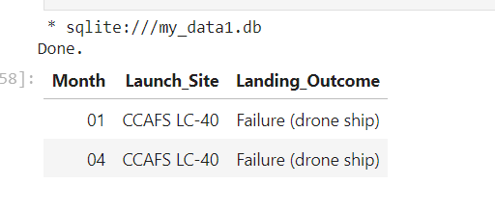
2015 Launch Records
List the failed landing_outcomes in drone ship, their booster versions, and launch site names for in year 2015

Slide 33
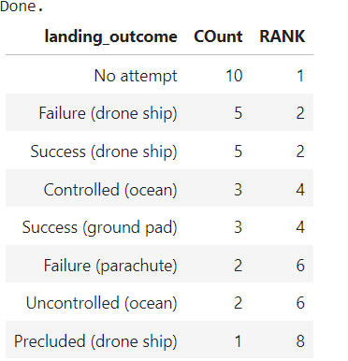
Rank Landing Outcomes Between 2010-06-04 and 2017-03-20
Rank the count of landing outcomes (such as Failure (drone ship) or Success (ground pad)) between the date 2010-06-04 and 2017-03-20, in descending order

Slide 34

Section 3

Slide 35
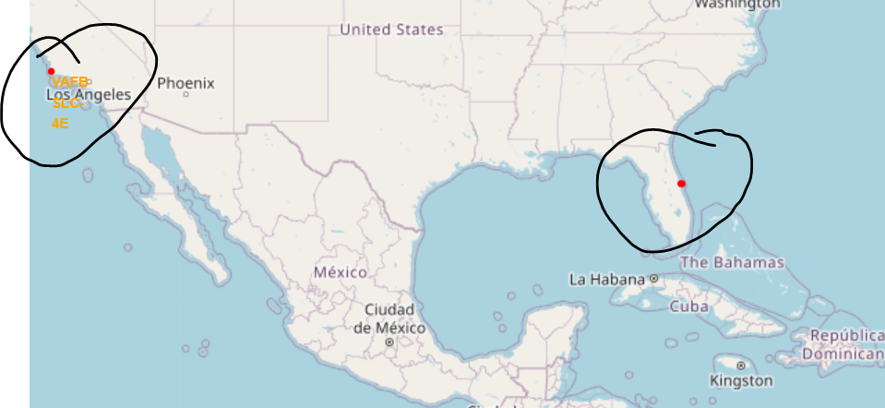
Map showing Spacex Launch coordinates
Explore the generated folium map and make a proper screenshot to include all launch sites’ location markers on a global map
Location markers showing the launch sites
Red one shows 3 launch sites and one near los angeles.

Slide 36
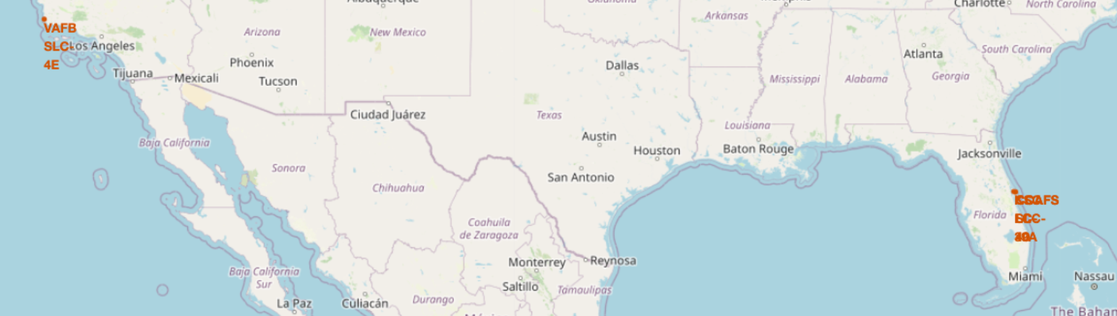
Map showing color labeled launch sites

Slide 37
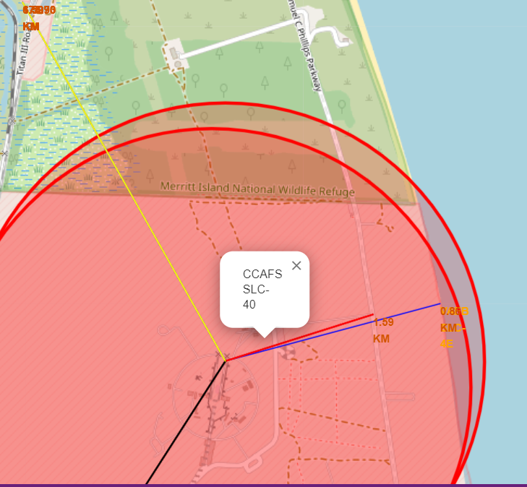
Map showing the proximities
Explore the generated folium map and show the screenshot of a selected launch site to its proximities such as railway, highway, coastline, with distance calculated and displayed
WE can see that the launch site CCAFS is near the coast line and distanced from city and railway.

Slide 38

Section 4

Slide 39
<Dashboard Screenshot 1>
Replace <Dashboard screenshot 1> title with an appropriate title
Show the screenshot of launch success count for all sites, in a piechart
Explain the important elements and findings on the screenshot

Slide 40
<Dashboard Screenshot 2>
Replace <Dashboard screenshot 2> title with an appropriate title
Show the screenshot of the piechart for the launch site with highest launch success ratio
Explain the important elements and findings on the screenshot

Slide 41
<Dashboard Screenshot 3>
Replace <Dashboard screenshot 3> title with an appropriate title
Show screenshots of Payload vs. Launch Outcome scatter plot for all sites, with different payload selected in the range slider
Explain the important elements and findings on the screenshot, such as which payload range or booster version have the largest success rate, etc.

Slide 42

Section 5

Slide 43
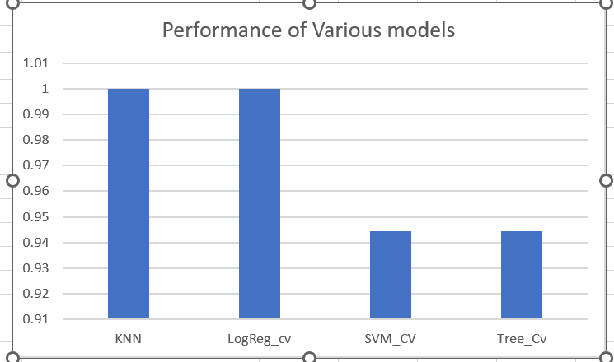
Classification Accuracy
Visualize the built model accuracy for all built classification models, in a bar chart
KNN and logReg model performs the best .

Slide 44
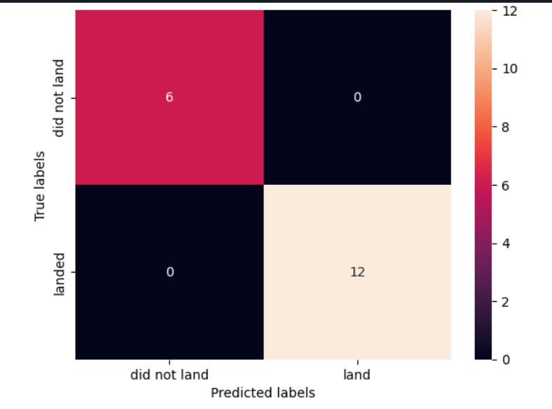
Confusion Matrix
Showing the confusion matrix of the best performing model.
KNN Model- which has correctly predicted all the 6 TRUE positives and 12 false negatives accurately. Hence we can go for this model for further prediction

Slide 45
Conclusions
The Launch sites can be selected be from CCFAS and the payload should not be more than 10000 kgs
It is more successful when the sites are near the coast
If the orbits are GEO,HEO and VLEO then the success rate is more.

Slide 46
Appendix
Include any relevant assets like Python code snippets, SQL queries, charts, Notebook outputs, or data sets that you may have created during this project

Slide 47


